Slide 1
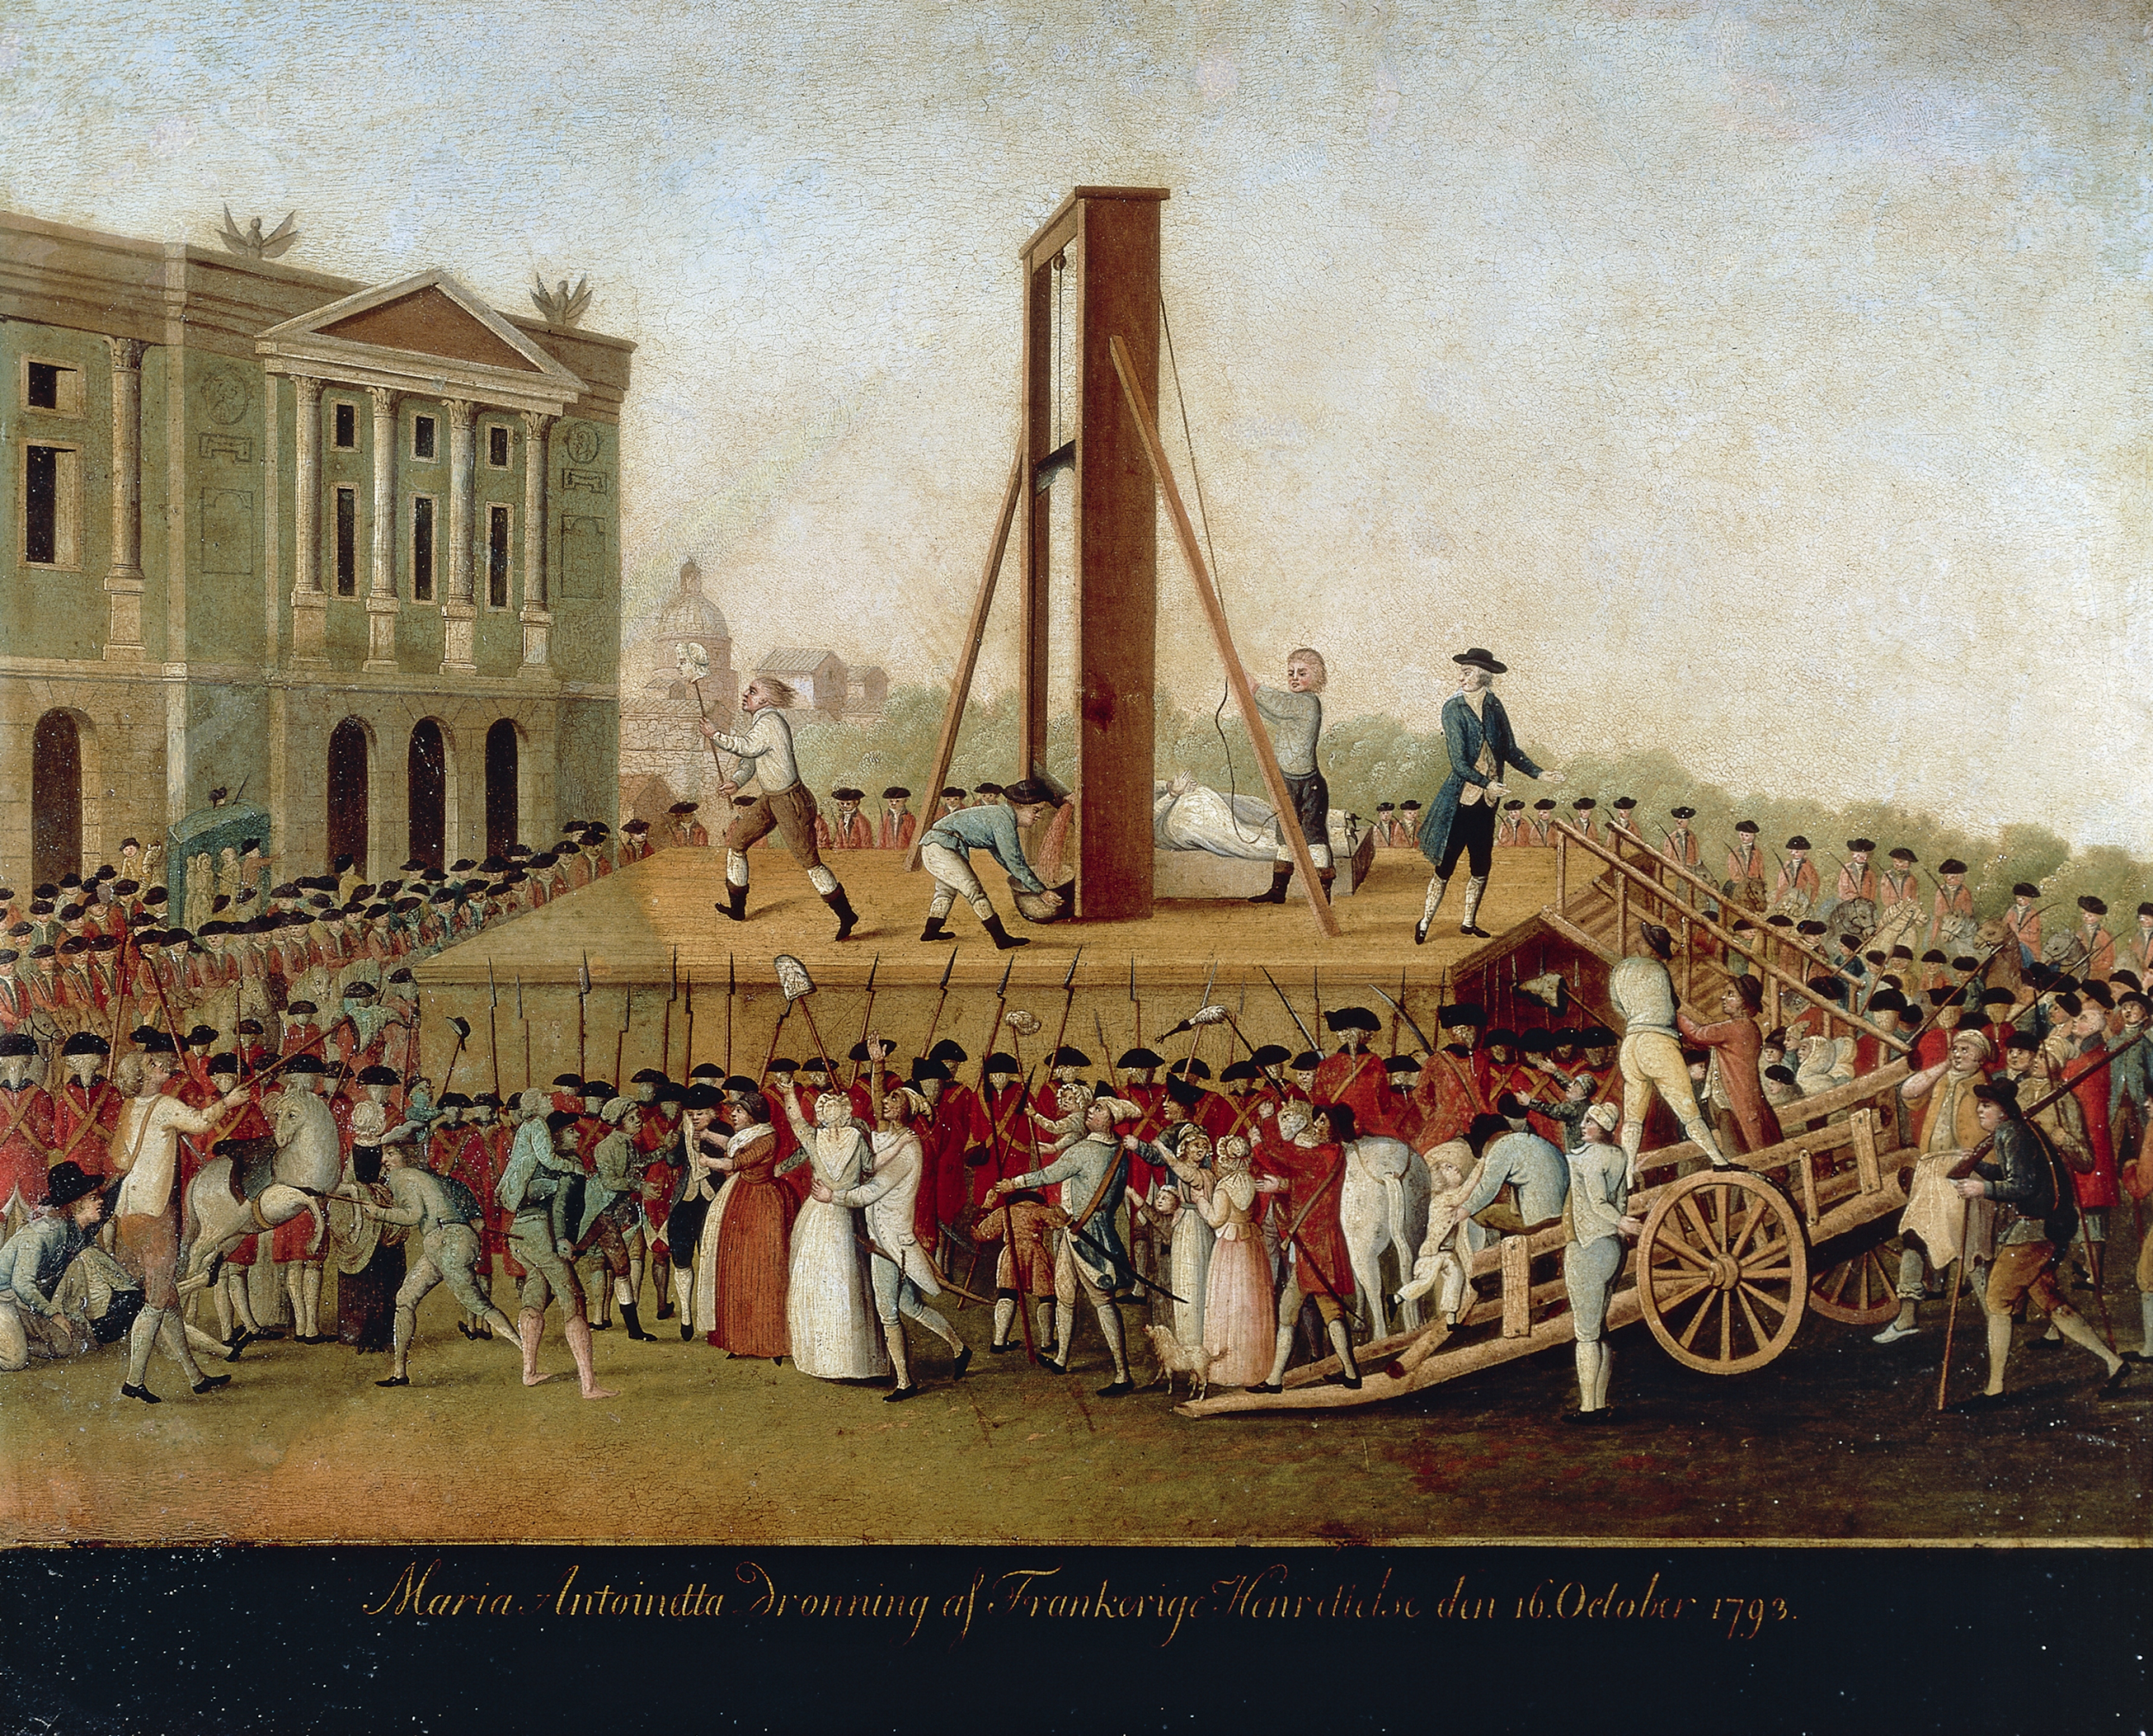
Intro to the French Revolution

Slide 2
What were some of the causes of the French Revolution?
- French society was still broken up into Ancien Regime. People were divided into three social classes.
- These social classes were known as ESTATES.
The three estates were :
The Clergy- enjoyed great wealth and privilege, consisted of high ranking church officials such as bishops and priests. They provided little social services and controlled 10% of the land.
The Nobles- This class was the titled nobility. They held most of the top jobs in the French government.

Slide 3
The Third Estate
The third estate is a very diverse class.
The top of the third estate consisted of the BOURGEOISIE, known as the middle class. These people were bankers, merchants, and manufacturers.
The remaining population of the third estate was rural peasants.
Traditional privileges allowed the first and second estate to pay almost no taxes.
Wages for the poor were so bad that the slightest raise in food prices had the potential to lead to starvation.
Enlightenment thinking caused the third estate to call for the privileged classes to pay their fair share.

Slide 4
CAUSES OF THE REVOLUTION
Financial Trouble
DEFICIT SPENDING- When a government spends more than it brings in.
The Seven Years War and the American Revolution put the French Government into a severe debt.
First and Second Estate opposed any kind of rule or law that required them to start paying taxes.
The Powerful classes wanted the king to call the ESTATES-GENERAL, which was the legislative body that consisted of representatives from all three estates.
To prepare for the Estates- General all three estates had to prepare CAHIERS . Which were notebooks listing their grievances.

Slide 5
THE NATIONAL ASSEMBLY
The third estate wanted each member of the Estates-General to have a vote as opposed to each estate having a single vote.
The purpose of this was to prevent the first and second estate from out voting the third estate.
When the king attempted to dismiss the National Assembly the Assembly would come together and form the famous TENNIS COURT OATH , which they swore to meet together until they established a sound and just constitution.
When many clergymen and Nobles joined the National Assembly the King was forced to accept it.

Slide 6
STORMING OF THE BASTILLE
On July 14th, 1789 almost a thousand French citizens gathered outside the Bastille- which was a medieval fortress that was used as a prison
The crowd demanded weapons that they believed was stored in the prison.
When the prison guards refused to open the gates, a fight broke out and the mob broke through the gates where they killed the commander of the prison and 5 guards.
The Bastille was a symbol of the Monarch and the storming of the Bastille threatened the Monarchs regime.
Bastille Day is now known in France as independence day.

Slide 7
AIM: How do we explain how the Revolution unfolded.
http://www.history.com/topics/french-revolution/videos/origins-of-the-french-revolution?m=528e394da93ae&s=undefined&f=1&free=false

Slide 8
Revolts Spread
Rumors begin the “Great Fear” in France
Rumors were being spread that the government was coming in and taking farmers crops.
Peasant farmers began to revolt against noble landowners who were trying to reimpose medieval land dues.
Peasants were consistently showing anger towards what they felt was an unjust regime.
FACTIONS- groups of people competing for power begin to pop up throughout France.

Slide 9
National Assembly Acts
After the Bastille falls the National Assembly meets on August 4th
The nobles are fearing further rebellions, so they agree to end their privileges.
Privileges include manorial dues, and most importantly the exemption from taxes.
The National Assembly abolished feudal systems throughout France.

Slide 10
Declaration of the Rights of Man
A written document that was a step towards a French Constitution.
Document Stated that:
All French men were born with equal rights and remain free.
People enjoyed Natural Rights of Liberty, Property, Security, and resistance to oppression.

Slide 11
The National Assembly continued to show its power by putting the Catholic Church under State control.
This was a controversial move and many people, including peasants were against this move.
CONSTITUTION OF 1791
Set up a limited Monarchy in France.
Legislative Assembly had the power to make laws, collect taxes, and decide on issues.

Slide 12
Radicals come into the National Assembly
Many people felt that the transformation was complete and that France was in a great position.
Radicals however, began to get elected into the Legislative Assembly and wanted to push their new government into other nations.
The Legislative Assembly began to wage war on other nations, such as Austria and Prussia, in order to push their new government.

Slide 13
Radical Days of the Revolution
The battles in other nations were not going well for the French troops.
Radicals felt that another change was necessary in order to make changes
The radicals were backed by the crowds of angry people and took control of the National Assembly in 1793
The National Convention was the legislative body that took over for the National Assembly

