Slide 1
Radicals continue to gain power
SUFFRAGE- the right to vote was extended to all male citizens, not just property owners.
The National Convention put Louis XVI on trial for treason. He was executed in 1793.
The execution of the King pushes France into the Reign of Terror.

Slide 2
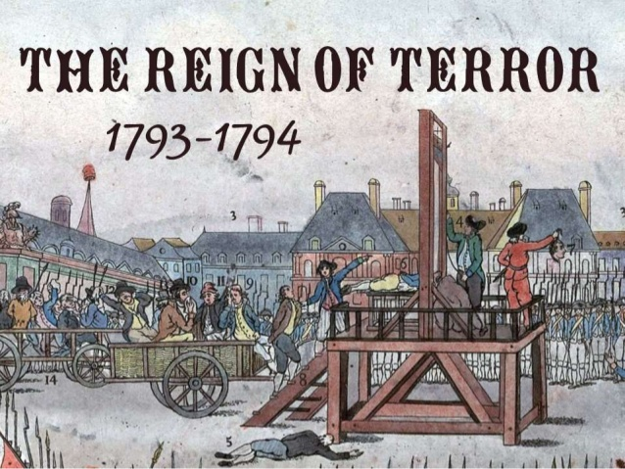
How do we explain the Reign of Terror

Slide 3
Committee of Public Safety
A 12 member committee that had almost absolute power
Were preparing France for All out War.
The committee was in charge of Trials and Executions in France.
Implemented mandatory tax for all people in France in order to pay for the war efforts.
Army invaded Italy, the Netherlands, and crushed peasant revolts in France.
“Freedom Fever” was being spread throughout conquered areas in support of the republic.

Slide 4
Maximilien Robespierre
“The incorruptible”
Became the leader of the Committee of Public Safety, which fought counterrevolutionaries.
He selflessly dedicated to the revolution.
His enemies called him a Tyrant.
“ Liberty cannot be secured, unless criminals lose their heads.”
He supported the ideas of Rousseau, to abolish slavery and religious tolerance.

Slide 5
300,000 people were arrested in France
17,000 people were executed during the reign of terror.
Many people were falsely accused, or mistaken for somebody else and sentenced to death.
Prisons became overcrowded and diseases began to spread.

Slide 6
Guillotine
The guillotine became the symbol of the revolution.
It was invented to be a more humane way to execute people.
Death was instant.
It was invented by Joseph Guillotin.

Slide 7
Terror comes to an End
In the Spring of 1794, the members of the national assembly began to fear the Committee of Public Safety.
Fearing for their lives they arrested Robespierre and executed him on July 28th
This led to a downfall in executions using the guillotine.
Citizens began to realize that the executions were unproductive and that most people in France were fearing for their lives.

Slide 8
Constitution of 1795
This constitution set up a 5 man directory and two house legislature.
Male property owners were able to vote
Middle class citizens and bourgeoisie were the dominant forces during this time
Corrupt political officials began to become a theme in France.
Wars continued in Great Britain and Austria,
Many people began to vote for officials who supported a constitutional Monarchy because people felt that the government was failing to do their job.

Slide 9
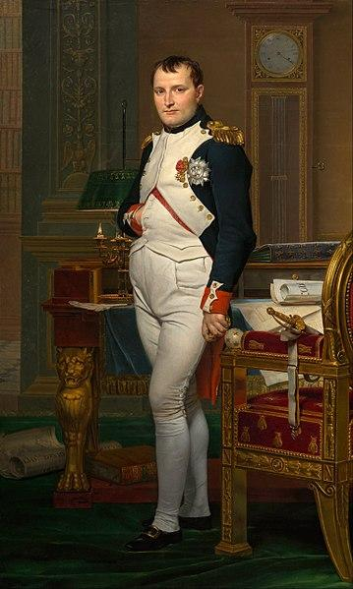
AIM: How do we explain the Rule of Napoleon

Slide 10
The Age of Napoleon
Napoleon supported the Jacobins, people that supported the republic
Bc of turmoil in the French Army during the revolution Napoleon rose quickly in military rank.
Napoleon won many battles and was loved by people in France
Lost a major battle in Egypt, but was able to hide it from the people in France by censoring the press and having spies in France.

Slide 11
Consul for Life
In 1799 Napoleon overthrew the Directory that was running France, and set up a governing board known as the Consulate.
Napoleon named himself First Consul, and then eventually Consul for Life.
After two years as a member of the first consul, Napoleon named himself the Emperor of France.
Napoleon had a very controversial coronation ceremony

Slide 12
The New Emperor
Throughout his rise to power, Napoleon held PLEBISCITE, popular vote by ballot.
Napoleon was strongly supported by the French people.
Democratic Despotism- when people believe they have a say in government but the emperor has absolute power.
Napoleon was so popular with the people because he was able to bring stability to France.

Slide 13
Order, Security, and Efficiency
Napoleon consolidated power and strengthened the central government.
The new regime rid france of liberty, equality, and fraternity and promoted order, security, and efficiency.
Napoleon made peace with the catholic church, brought prosperity back to the french economy.
Improved French Infrastructure, and encouraged new industry.

Slide 14
Napoleon opened jobs to middle class people based on talents
Peasants got to keep the land they purchased from the catholic church during the revolution.
Napoleon was able to gain support from people in all social classes
All Napoleon supporters had to swear an oath of loyalty to the emperor.

Slide 15
Napoleonic Code
Napoleon’s longest lasting reform
It was a new code of laws in France.
New set of laws were based on enlightenment philosophies.
religious tolerance, equality of all citizens, abolition of feudalism.
Men were granted more rights as head of the household and women lost some of their newly gained rights.

Slide 16
Napoleon continues his Conquest
Napoleon continued his leadership on the battlefield and continued to conquer land in Europe.
Napoleon Annexed, the Netherlands, Belgium, and parts of Italy and Germany.
France gained control of most of Europe using forceful diplomacy.
Nationalism was on the rise.

Slide 17
Napoleon attempted to conquer Britain by cutting off its resources. Napoleon knew that Britain’s navy was too powerful and he had to find a way to conquer them. Napoleon ultimately fails and Britain remains out of Napoleon control.

Slide 18
Russia costs Napoleon
When Napoleon attempts to conquer Russia he faces many obstacles.
Scorched-Earth Policy, burning villages and crops in order to prevent french troops from having food or shelter from the harsh russian winter.

Slide 19
Napoleon is Abdicated
In 1814, Napoleon was Abdicated, or stepped down from power
Napoleon was exiled to Elba, which was an island in the mediterranean.
Louis XVIII took power as the king of France.
Napoleon would make one final return to france and regain control for about three months.

Slide 20
At Waterloo Napoleon did Surrender
British forces would team up with Prussian armies and take Napoleon down at Waterloo.
Waterloo is a city in Belgium
Napoleon would be exiled again, this time to St. Helena where he would never make a return to France. He would have a lasting impact.

Slide 21
Congress of Vienna
After Napoleon’s second exile the Heads of State met at Congress of Vienna
10 month conference from September 1814-June 1815
Diplomats and royalty dined, danced, and discussed the future of European politics
France was represented by Prince Charles Maurice de Talleyrand

Slide 22
The Congress tries for Peace
The ultimate goal of the Congress was to ensure lasting peace in Europe
Wanted to establish a balance in power and restore monarchies
Wanted to go back to Europe in 1792
A “holy alliance” was suggested
European leaders wanted to ensure that French military forces couldn’t gain that much power again

Slide 23
Talleyrand was a very smart, shrewd diplomat who worked hard to work other nations against each other in order to protect France’s interest
The map of Europe was withdrawn
Belgium and Luxembourg went to Holland and created the Kingdom of the Netherlands.
Austria regained control over northern Italy
Legitimacy was restored, restoring hereditary monarchies.
France, Portugal, and Italy restored monarchs.

Slide 24
Concert of Europe
The leaders in Europe agreed to meet periodically to discuss problems affecting peace in Europe.
The quadruple alliance, Austria, Russia, Prussia, and Great Britain, extended their alliance
The immediate result of the Congress of Vienna was to achieve lasting peace in Europe. This is effective, however, peace would only last about 100 years.

